Slide 1


GA-Net: Guided Aggregation Net for End-to-end Stereo Matching
Feihu Zhang, Victor Prisacariu, Ruigang Yang, Philip H.S. Torr
University of Oxford, Baidu Research
Notes:
This is the presentation of the paper: “Guided Aggregation Net for end to end stereo matching”. The project is a cooperation between University of Oxford and Baidu Research.

Slide 2
Key Steps of Stereo Matching
Feature Extraction
-Patches [Zbontar et al. 2015], Pyramid [Chang et al. 2018],
Encoder-decoder [Kendall et al. 2017], etc.
Matching Cost Aggregation
-Feature based matching cost is often ambiguous
-Wrong matches easily have a lower cost than correct ones
Disparity Estimation
-Classification loss, Disparity regression [Kendall et al. 2017]
Notes:
There are three Key steps for stereo matching. We focus on the Matching Cost Aggregation. There are already many successful methods for feature extraction and disparity estimation in deep neural networks. But, the feature based matching cost is often ambiguous and produces a lot of wrong matches.

Slide 3
Key Steps of Stereo Matching
Feature Extraction
-Patches [Zbontar et al. 2015], Pyramid [Chang et al. 2018],
Encoder-decoder [Kendall et al. 2017], etc.
Matching Cost Aggregation
-Feature based matching cost is often ambiguous
-Wrong matches easily have a lower cost than correct ones
Disparity Estimation
-Classification loss, Disparity regression [Kendall et al. 2017]
Notes:
There are already many successful methods for feature extraction and disparity estimation in deep neural networks. We focus on the Matching Cost Aggregation. But, the feature based matching cost is often ambiguous and produce a lot of wrong matches.

Slide 4
Matching Cost Aggregation
Deep Neural Networks
-Only 2D/3D convolutions
Traditional
-Geometric, Optimization
-SGM [Hirschmuller. 2008], CostFilter [Hosni et al. 2013], etc.
Target: Formulate traditional geometric & optimization into DNN
Notes:
For matching cost aggregation, There are many effective traditional methods. Including the SGM, CostFilter which are always based on geometric and optimization.
But, for deep neural networks, only convolutions layers are used currently. Our target is to formulate the traditional geometric and optimization into Deep Nueral Networks.

Slide 5
Contributions: Guided Aggregation Layers
Semi-Global Aggregation (SGA) Layer
-Differentiable SGM.
-Over Whole Images.
Local Guided Aggregation (LGA) Layer
-Learned Guided Filtering.
-Refine Thin Structures and Edges.
-Recover Loss of Accuracy in Down-sampling.
Notes:
Our contributions are two guided aggregation layers in deep neural networks. The first is the Semi-Global Aggregation (SGA) layer which is a differentiable approximation of SGM.
The second is the local guided aggregation(LGA) layer, which helps refine the thin structures and edges.

Slide 6

Problem Statement
Energy Function for Stereo Matching
-Find the best disparity map D* that minimize:
Sum of Matching Costs
Smoothness Penalties
Notes:
The stereo matching can be formulate as such a energy function. The first of the energy function is the sum of matching costs. The second term is the smoothness penalties.

Slide 7

Semi-global Matching
Approximate Solution using Cost Aggregation:
- Produce only zeros.
- Not immediately differentiable.
- Produce fronto-parallel surfaces.
- User-defined parameters.
- Hard to tune.
- Fixed for all locations.
Notes:
But, it’s difficulty to use the SGM equation into Deep neural Networks models. Because the minimum selections only produces zeros and are not immediately differentiable.
The user defined parameters are also hard to tune.

Slide 8

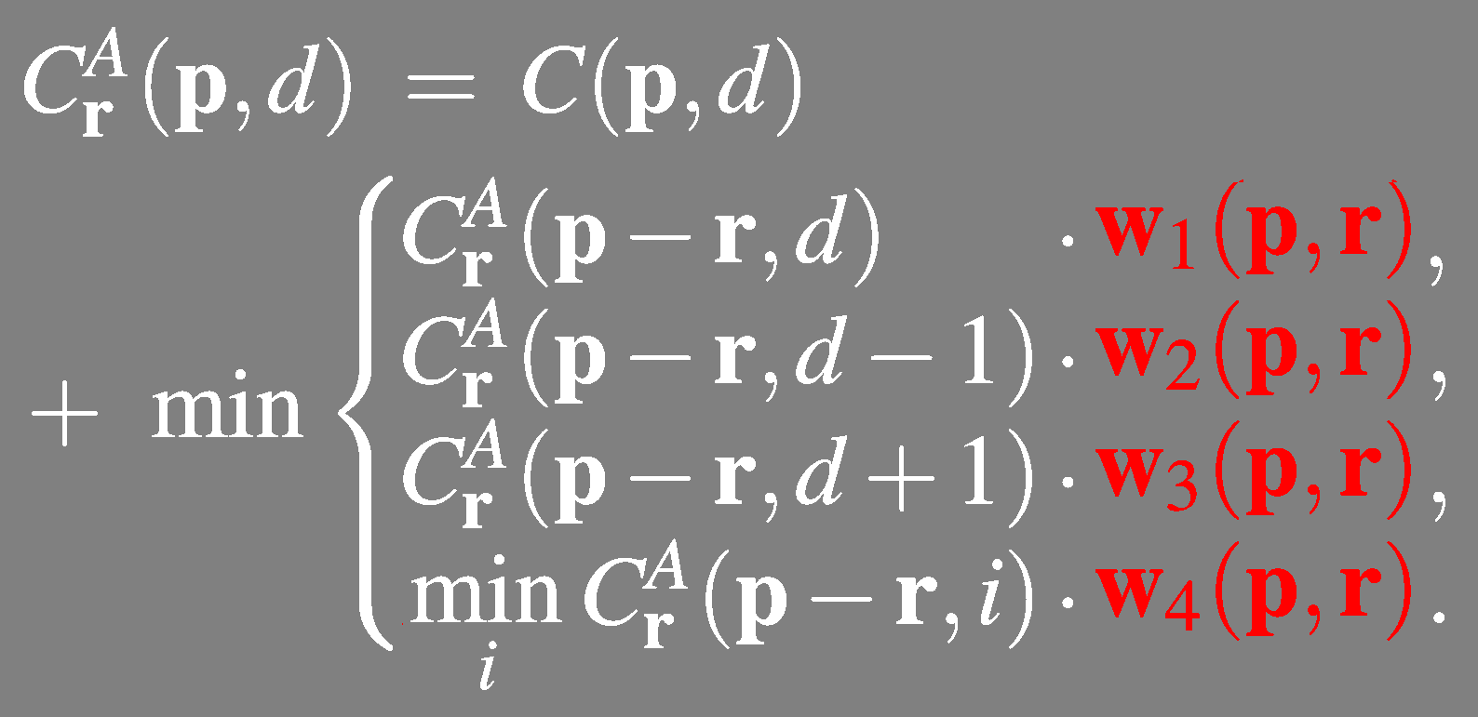
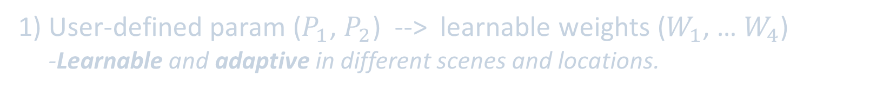
SGM to SGA Layer
1) User-defined param ($P_{1}$, $P_{2}$) --> learnable weights ($W_{1}$, … $W_{4}$)
-Learnable and adaptive in different scenes and locations.
Notes:
We revise and improve the SGM equation to get our SGA equation. First, we replace the user defined parameters with the learnable weights which are also adaptive in different scenes and locations.
Second, we change the second minimum selection to maximum selection which are more effective in deep neural network models and helps maximize the probability at the ground truth labels.
Finally, we use weighted sum to replace the first minimum. This is proven effective in the paper “all convolutional net” and there is no loss in accuracy.

Slide 9
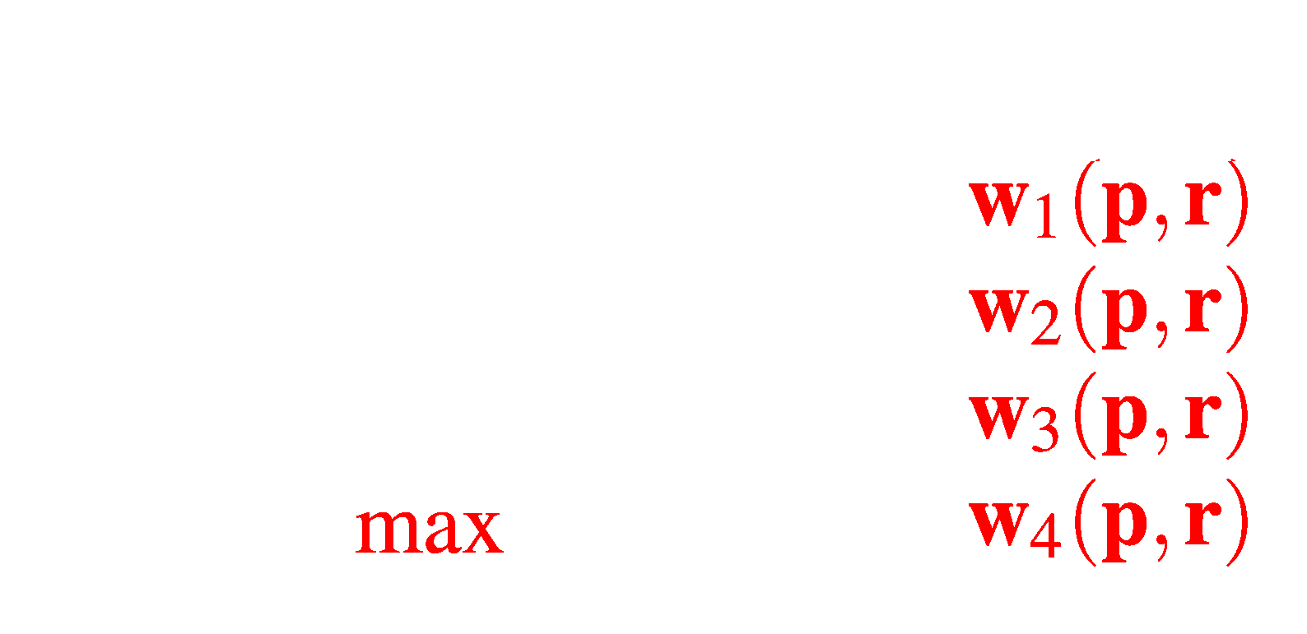
SGM to SGA Layer
2) Second/internal “min” --> “max” selection
-Maximize the probability at the ground truth labels.
-Avoid zeros and negatives, more effective.
Notes:
We revise and improve the SGM equation to get our SGA equation. First, we replace the user defined parameters with the learnable weights which are also adaptive in different scenes and locations.
Second, we change the second minimum selection to maximum selection which are more effective in deep neural network models and helps maximize the probability at the ground truth labels.
Finally, we use weighted sum to replace the first minimum. This is proven effective in the paper “all convolutional net” and there is no loss in accuracy.

Slide 10
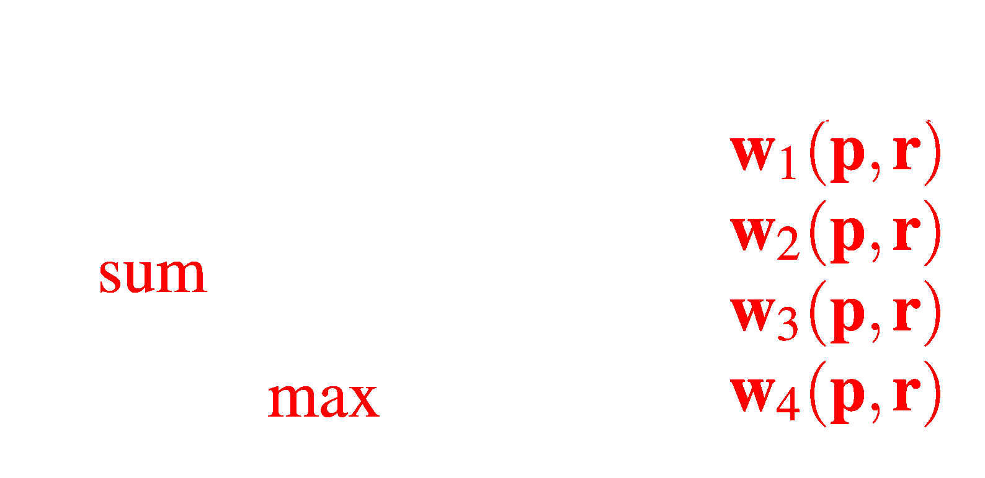
SGM to SGA Layer
3) First “min” --> weighted “sum”
-Proven effective in [Springenberg, et al, 2014], no loss in accuracy.
-Reduce fronto-parallel surfaces in textureless regions.
-Avoid zeros and negatives.
Notes:
We revise and improve the SGM equation to get our SGA equation. First, we replace the user defined parameters with the learnable weights which are also adaptive in different scenes and locations.
Second, we change the second minimum selection to maximum selection which are more effective in deep neural network models and helps maximize the probability at the ground truth labels.
Finally, we use weighted sum to replace the first minimum. This is proven effective in the paper “all convolutional net” and there is no loss in accuracy.

Slide 11



LGA Layer
Cost Filter:
- Filtering cost volume C
in local region $N_{P}$.
LGA Layer:
- Refine thin structures
- Recover loss of accuracy
in down-sampling
Notes:
And for our local guided aggregation layer, we improve the traditional cost filter strategy and learned guided filters kernels to refine the thin structures.

Slide 12
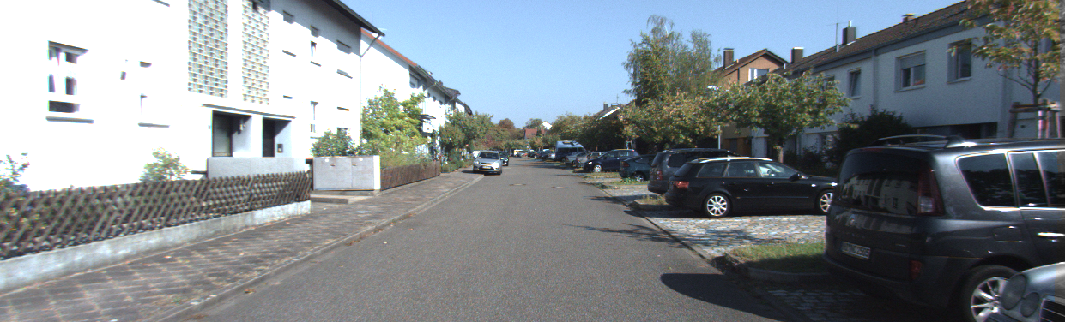
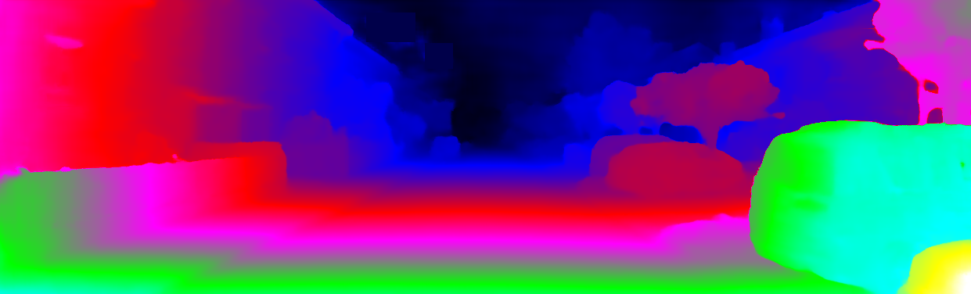
Network Architecture
Learning Guidance
... …
.. ..
SGA
SGA
SGA
LGA
Feature Extraction
Cost Volume
Cost Aggregation
Disparity Estimation
max
SGA Layer
LGA Layer
Notes:
This is our network architecture. We focus on the cost aggregation and use extra convolutional net to learn the guided weights for our SGA and LGA layers. The sga layer aggregation semi-globally in different directions over the whole image. The LGA layer aggregate in a local regions for each pixel to refine thin structures. Several SGA and two LGA layers are used in such a cost aggregation step.

Slide 13
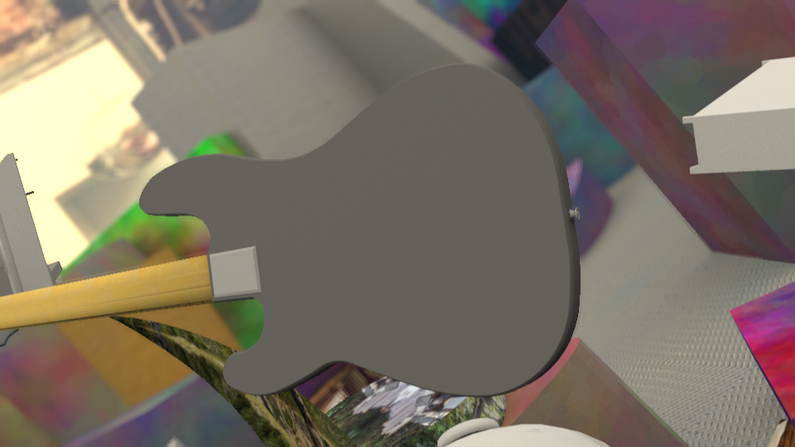
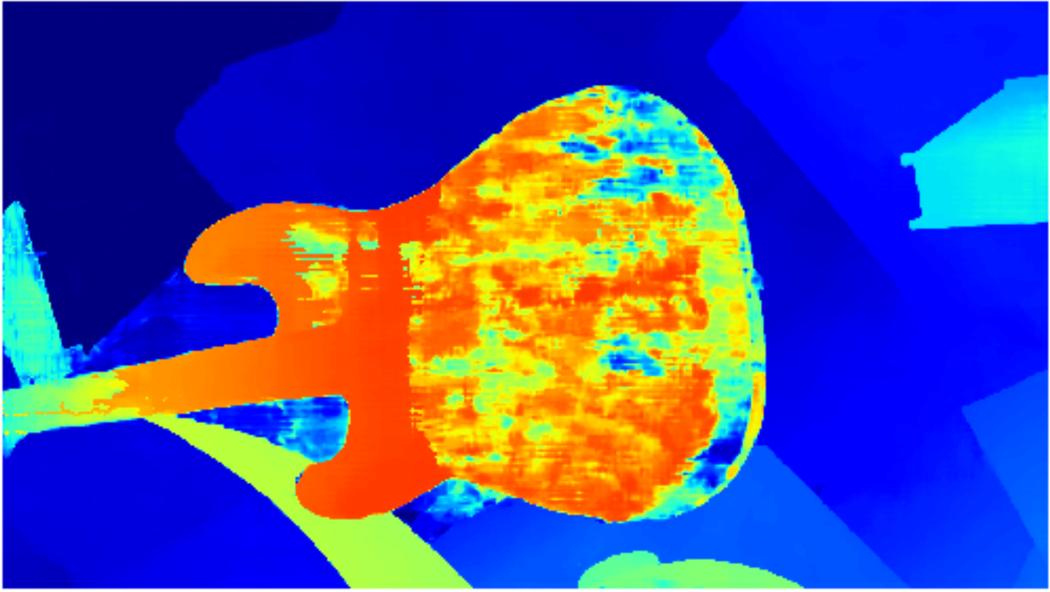
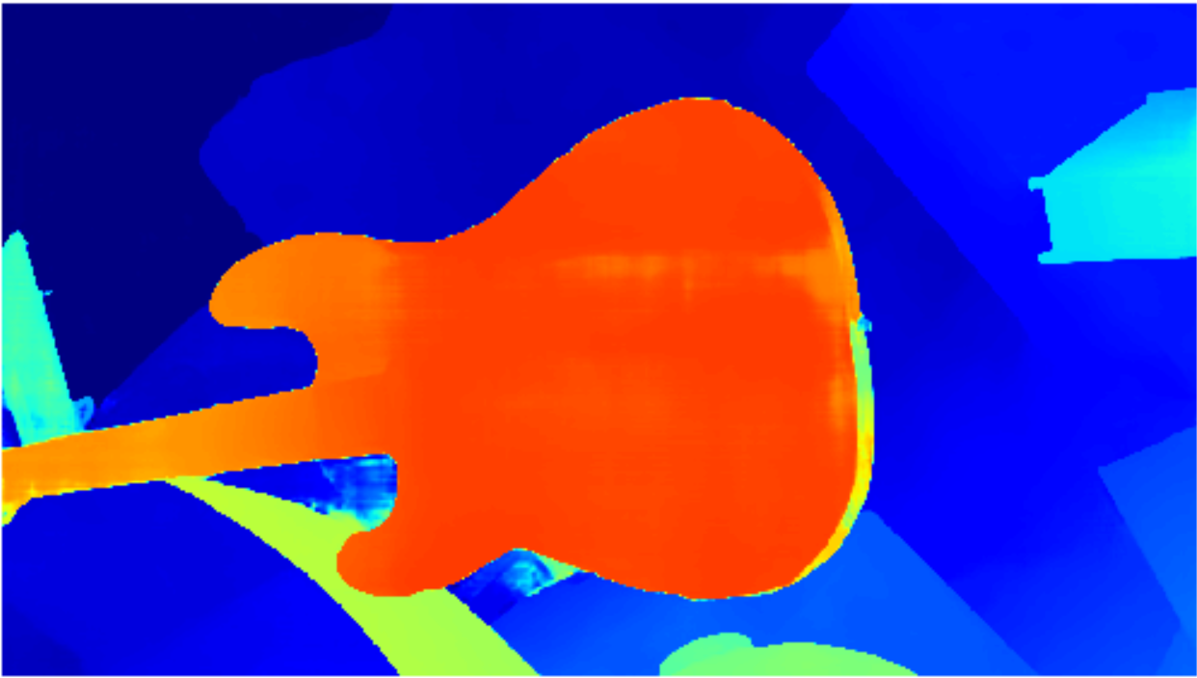
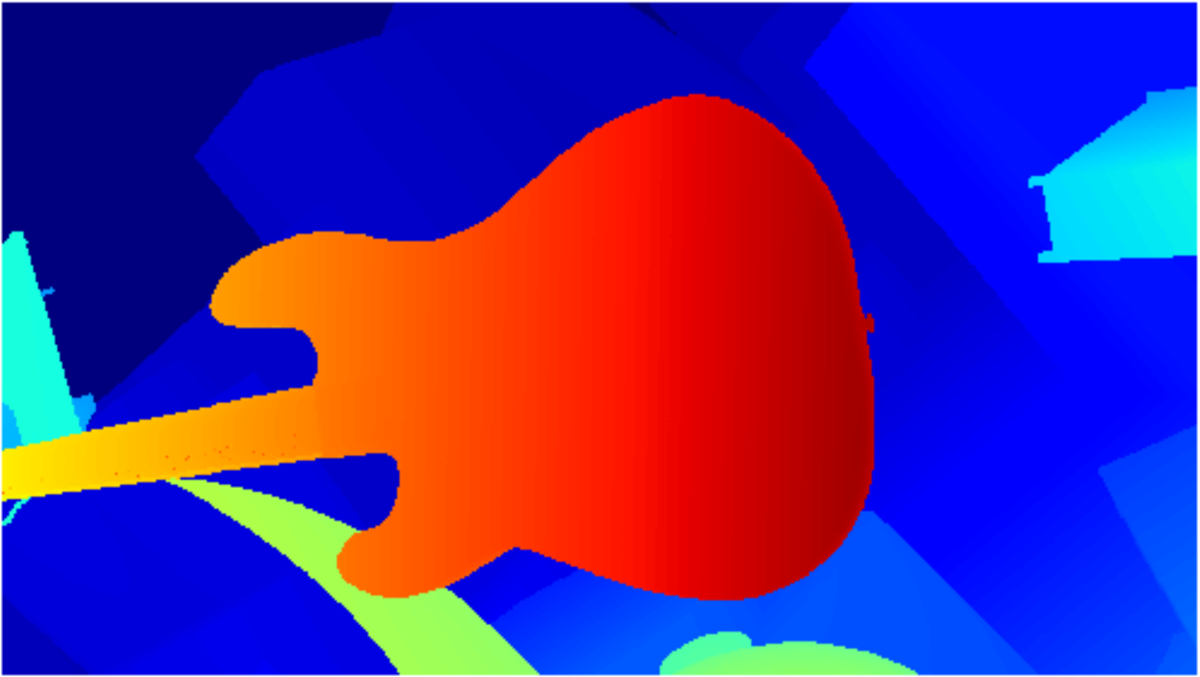
Experimental Results
Input
GC-Net [Kendall et al. 2017]
Our GANet-2
Ground Truth
Notes:
In the experiments, our guided aggregation net far outperforms the state-of-the-art deep neural network models in both sceneflow dataset and the Kitti outdoor scenes.

Slide 14
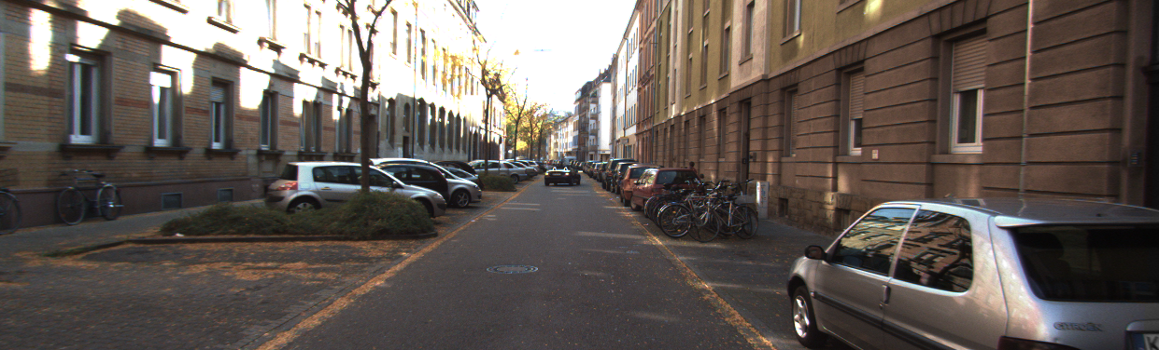
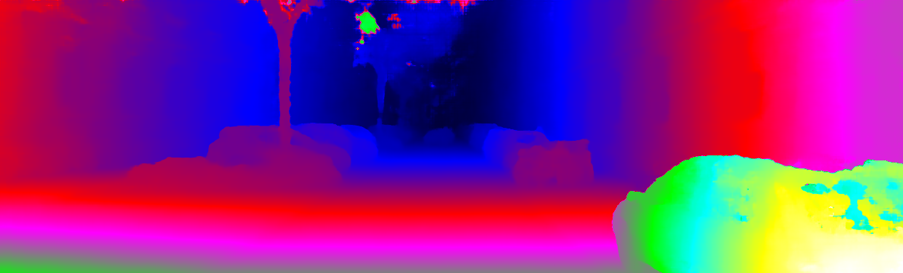

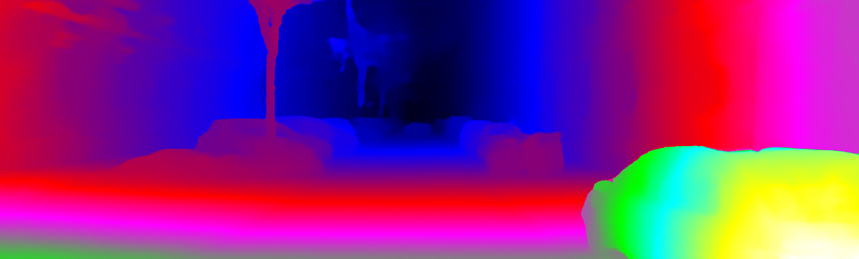
Experimental Results
Input
GC-Net [Kendall et al. 2017]
PSMNet [Chang et al. 2018]
Our GANet

Slide 15
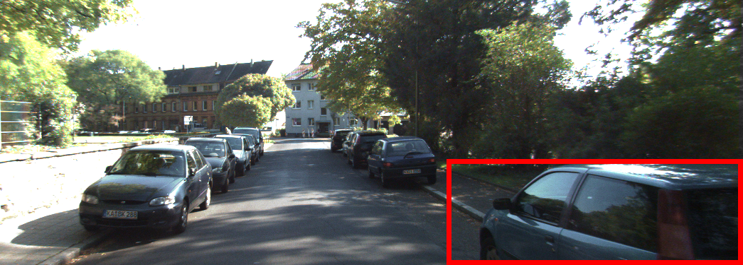
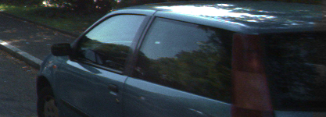
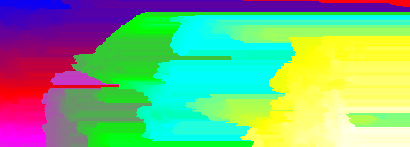
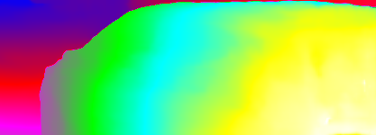
Experimental Results
Input
Large textureless region
SGM
Our GANet
Notes:
And compared with the original SGM, our model helps avoid most of the fronto-parallel surfaces in the large textureless regions.

Slide 16

Code and Models Available:
https://github.com/feihuzhang/GANet
Notes:
The code and models are available now.

